Slide 1
Objectives
In this session, you will learn to:
Use functions to customize the result set
Summarize and group data

Slide 2
Demo: Customizing the Result Set
Problem Statement:
The management at AdventureWorks, Inc. wants to view a report that displays the employee ID, designation, and age of the employees who are working as marketing managers or marketing specialists. The data should be displayed in uppercase.
The employee details are stored in the Employee table in the AdventureWorks database. How will you display the required data?
Notes:
You can summarize the session by running through the summary given in SG.
In addition, you can also ask students summarize what they have learnt in this session.

Slide 3
Demo: Customizing the Result Set (Contd.)
Solution:
To solve the preceding problem, you need to perform the following tasks:
Create a query.
Execute the query to display the data.
Notes:
You can summarize the session by running through the summary given in SG.
In addition, you can also ask students summarize what they have learnt in this session.

Slide 4
Summarizing and Grouping Data
How can I summarize and group data?

Slide 5
Summarizing and Grouping Data (Contd.)
SQL Server provides aggregate functions to generate summarized data.
Notes:
5
Student already have learnt about type 2 SCDs in Module I. Therefore, you can start this topic by asking the following questions to students:
What are type 2 SCDs?
Given an example to explain type 2 SCDs.
This will recapitulate what they have learnt about type 2 SCD in Module 1.
Now explain the strategy to update the data into these dimension tables with help the example given in SG.
After explaining the examples, you can ask students to think of an example of a type 2 SCD and then tell the strategy to update the data into this dimension table.

Slide 6
Summarizing Data by Using Aggregate Functions
Aggregate functions:
Summarize the values for a column or a group of columns, and produce a single value.
Syntax:
SELECT aggregate_function([ALL|DISTINCT] expression) FROM table_name
Notes:
6
Student already have learnt about type 2 SCDs in Module I. Therefore, you can start this topic by asking the following questions to students:
What are type 2 SCDs?
Given an example to explain type 2 SCDs.
This will recapitulate what they have learnt about type 2 SCD in Module 1.
Now explain the strategy to update the data into these dimension tables with help the example given in SG.
After explaining the examples, you can ask students to think of an example of a type 2 SCD and then tell the strategy to update the data into this dimension table.

Slide 7
Summarizing Data by Using Aggregate Functions (Contd.)
You can calculate summary values by using the following aggregate functions:
Avg()
Count()
Min()
Max()
Sum()
Notes:
7
Student already have learnt about type 2 SCDs in Module I. Therefore, you can start this topic by asking the following questions to students:
What are type 2 SCDs?
Given an example to explain type 2 SCDs.
This will recapitulate what they have learnt about type 2 SCD in Module 1.
Now explain the strategy to update the data into these dimension tables with help the example given in SG.
After explaining the examples, you can ask students to think of an example of a type 2 SCD and then tell the strategy to update the data into this dimension table.

Slide 8
Summarizing Data by Using Aggregate Functions (Contd.)
Avg():
Returns the average of values in a numeric expression, either all or distinct.
For example:
SELECT 'Average Rate' = avg (Rate) FROM HumanResources.EmployeePayHistory
Count():
Returns the number of values in an expression, either all or distinct.
For example:
SELECT 'Unique Rate' = count (DISTINCT Rate) FROM HumanResources.EmployeePayHistory
Notes:
8
Student already have learnt about type 2 SCDs in Module I. Therefore, you can start this topic by asking the following questions to students:
What are type 2 SCDs?
Given an example to explain type 2 SCDs.
This will recapitulate what they have learnt about type 2 SCD in Module 1.
Now explain the strategy to update the data into these dimension tables with help the example given in SG.
After explaining the examples, you can ask students to think of an example of a type 2 SCD and then tell the strategy to update the data into this dimension table.

Slide 9
Summarizing Data by Using Aggregate Functions (Contd.)
Min():
Returns the lowest value in the expression.
For example:
SELECT 'Minimum Rate' = min (Rate) FROM HumanResources.EmployeePayHistory
Max():
Returns the highest value in the expression.
For example:
SELECT 'Maximum Rate' = max (Rate) FROM HumanResources.EmployeePayHistory
Sum():
Returns the sum total of values in a numeric expression, either all or distinct.
For example:
SELECT 'Sum' = sum (DISTINCT Rate) FROM HumanResources.EmployeePayHistory
Notes:
9
Student already have learnt about type 2 SCDs in Module I. Therefore, you can start this topic by asking the following questions to students:
What are type 2 SCDs?
Given an example to explain type 2 SCDs.
This will recapitulate what they have learnt about type 2 SCD in Module 1.
Now explain the strategy to update the data into these dimension tables with help the example given in SG.
After explaining the examples, you can ask students to think of an example of a type 2 SCD and then tell the strategy to update the data into this dimension table.

Slide 10
Just a minute
What would be the output of the following query?
SELECT 'Maximum Rate' = max (UnitPrice)
FROM Sales.SalesOrderDetail
Solution:
The query displays the maximum unit price from the SalesOrderDetail table.
Notes:
10
Student already have learnt about type 2 SCDs in Module I. Therefore, you can start this topic by asking the following questions to students:
What are type 2 SCDs?
Given an example to explain type 2 SCDs.
This will recapitulate what they have learnt about type 2 SCD in Module 1.
Now explain the strategy to update the data into these dimension tables with help the example given in SG.
After explaining the examples, you can ask students to think of an example of a type 2 SCD and then tell the strategy to update the data into this dimension table.

Slide 11
Grouping Data
You can group the data by using the GROUP BY, COMPUTE, COMPUTE BY, and PIVOT clauses of the SELECT statement.
Notes:
11
Student already have learnt about type 2 SCDs in Module I. Therefore, you can start this topic by asking the following questions to students:
What are type 2 SCDs?
Given an example to explain type 2 SCDs.
This will recapitulate what they have learnt about type 2 SCD in Module 1.
Now explain the strategy to update the data into these dimension tables with help the example given in SG.
After explaining the examples, you can ask students to think of an example of a type 2 SCD and then tell the strategy to update the data into this dimension table.

Slide 12
Grouping Data (Contd.)
The GROUP BY clause:
Summarizes the result set into groups as defined in the SELECT statement by using aggregate functions.
Uses the HAVING clause to further restrict the result set to produce the data based on a condition.
Syntax:
SELECT column_list
FROM table_name
WHERE condition
[GROUP BY [ALL] expression [, expression]
[HAVING search_condition]
Notes:
12
Student already have learnt about type 2 SCDs in Module I. Therefore, you can start this topic by asking the following questions to students:
What are type 2 SCDs?
Given an example to explain type 2 SCDs.
This will recapitulate what they have learnt about type 2 SCD in Module 1.
Now explain the strategy to update the data into these dimension tables with help the example given in SG.
After explaining the examples, you can ask students to think of an example of a type 2 SCD and then tell the strategy to update the data into this dimension table.

Slide 13
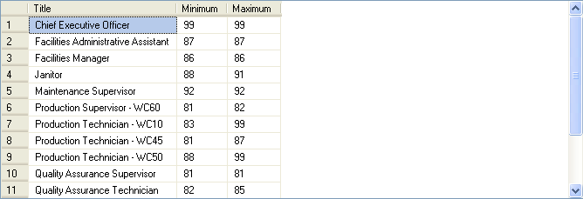
Grouping Data (Contd.)
For example:
SELECT Title, Minimum = min(VacationHours), Maximum = max(VacationHours) FROM HumanResources.Employee WHERE VacationHours > 80 GROUP BY Title
Output
Displays the minimum and maximum values of vacation hours for the different types of titles.
Notes:
13
Student already have learnt about type 2 SCDs in Module I. Therefore, you can start this topic by asking the following questions to students:
What are type 2 SCDs?
Given an example to explain type 2 SCDs.
This will recapitulate what they have learnt about type 2 SCD in Module 1.
Now explain the strategy to update the data into these dimension tables with help the example given in SG.
After explaining the examples, you can ask students to think of an example of a type 2 SCD and then tell the strategy to update the data into this dimension table.

Slide 14
Grouping Data (Contd.)
The GROUPING SETS clause is used to combine the result generated by multiple GROUP BY clauses into a single result set.
For example:
SELECT Region, Department, AVG(SAL)
AverageSalary FROM EmpTable
GROUP BY
GROUPING SETS
(
(Region, Department),
(Region),
(Department)
)
Notes:
14
Student already have learnt about type 2 SCDs in Module I. Therefore, you can start this topic by asking the following questions to students:
What are type 2 SCDs?
Given an example to explain type 2 SCDs.
This will recapitulate what they have learnt about type 2 SCD in Module 1.
Now explain the strategy to update the data into these dimension tables with help the example given in SG.
After explaining the examples, you can ask students to think of an example of a type 2 SCD and then tell the strategy to update the data into this dimension table.

Slide 15
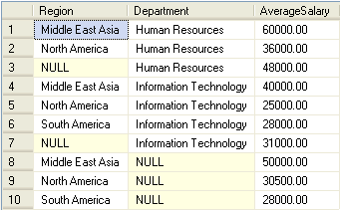
Grouping Data (Contd.)
The following figure displays the output of the preceding query.
The rows that do not have NULL values represent the average salary of the employees grouped for each region and department.
The rows that contain NULL values in the Department column represent the average salary of the employees for each region.
The rows that contain NULL values in the Region column represent the average salary of the employees for each department.
Notes:
15
Student already have learnt about type 2 SCDs in Module I. Therefore, you can start this topic by asking the following questions to students:
What are type 2 SCDs?
Given an example to explain type 2 SCDs.
This will recapitulate what they have learnt about type 2 SCD in Module 1.
Now explain the strategy to update the data into these dimension tables with help the example given in SG.
After explaining the examples, you can ask students to think of an example of a type 2 SCD and then tell the strategy to update the data into this dimension table.

Slide 16
Grouping Data (Contd.)
COMPUTE and COMPUTE BY:
The COMPUTE clause is used to generate summary rows by using aggregate functions in the query results.
The COMPUTE BY clause can be used to calculate summary values of the result set on a group of data.
Syntax:
SELECT column_list
FROM table_name
ORDER BY column_name
COMPUTE aggregate_function (column_name) [, aggregate_function (column_name)...] [BY column_name [, column_name]...]
Notes:
16
Student already have learnt about type 2 SCDs in Module I. Therefore, you can start this topic by asking the following questions to students:
What are type 2 SCDs?
Given an example to explain type 2 SCDs.
This will recapitulate what they have learnt about type 2 SCD in Module 1.
Now explain the strategy to update the data into these dimension tables with help the example given in SG.
After explaining the examples, you can ask students to think of an example of a type 2 SCD and then tell the strategy to update the data into this dimension table.

Slide 17
Grouping Data (Contd.)
For example:
SELECT Title, 'Total VacationHours' = VacationHours, 'Total SickLeaveHours' = SickLeaveHours FROM HumanResources.Employee WHERE Title IN ('Recruiter', 'Stocker') ORDER BY Title, VacationHours, SickLeaveHours COMPUTE SUM(VacationHours), SUM(SickLeaveHours
Notes:
You can summarize the session by running through the summary given in SG.
In addition, you can also ask students summarize what they have learnt in this session.

Slide 18
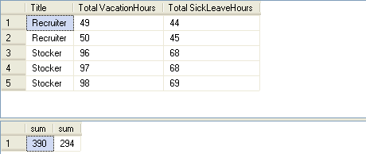
Grouping Data (Contd.)
The following figure displays the output of the preceding query.
Notes:
You can summarize the session by running through the summary given in SG.
In addition, you can also ask students summarize what they have learnt in this session.

Slide 19
Grouping Data (Contd.)
The PIVOT clause:
Is used to transform a set of columns into values.
Rotates a table-valued expression by turning the unique values from one column in the expression into multiple columns in the output.
Syntax:
SELECT * from table_name
PIVOT (aggregation_function (value_columhe)
FOR pivot_column
IN (column_list)
) table_alias
Notes:
You can summarize the session by running through the summary given in SG.
In addition, you can also ask students summarize what they have learnt in this session.

Slide 20
Grouping Data (Contd.)
For example:
SELECT VendorID, [164] AS Emp1, [198] AS Emp2, [223] AS Emp3, [231] AS Emp4, [233] AS Emp5
FROM
(SELECT PurchaseOrderID, EmployeeID, VendorID
FROM Purchasing.PurchaseOrderHeader) p
PIVOT
(
COUNT (PurchaseOrderID)
FOR EmployeeID IN
( [164], [198], [223], [231], [233] )
) AS pvt
ORDER BY VendorID
Notes:
You can summarize the session by running through the summary given in SG.
In addition, you can also ask students summarize what they have learnt in this session.

Slide 21
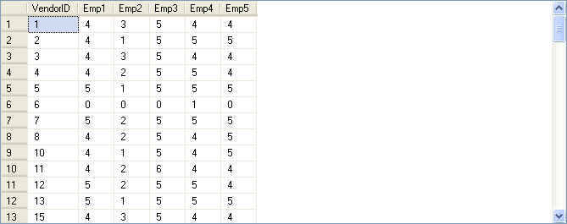
Grouping Data (Contd.)
The following figure displays the output of the preceding query.
Displays the number of purchase orders placed by certain employees, laid down with the vendors.
Notes:
You can summarize the session by running through the summary given in SG.
In addition, you can also ask students summarize what they have learnt in this session.

Slide 22
Just a minute
When grouping data, which of the following clauses helps eliminate the groups that do not match the specified condition?
NOT IN
HAVING
WHERE
COMPUTE
Solution:
2. HAVING
Notes:
You can summarize the session by running through the summary given in SG.
In addition, you can also ask students summarize what they have learnt in this session.

Slide 23
Just a minute
Match the column A with column B.
Column A | Column B
COMPUTE | Transforms a set of columns into values.
PIVOT | Removes leading blanks from the character expression.
Str | Generates summary rows by using aggregate functions in the query results.
Ltrim | Converts numeric data to character data.
Solution:
Column A | Column B
COMPUTE | Generates summary rows by using aggregate functions in the query results.
PIVOT | Transforms a set of columns into values.
Str | Converts numeric data to character data.
Ltrim | Removes leading blanks from the character expression.
Notes:
You can summarize the session by running through the summary given in SG.
In addition, you can also ask students summarize what they have learnt in this session.

Slide 24
Demo: Summarizing and Grouping Data
Problem Statement:
You are a database developer at AdventureWorks, Inc. The management wants to view the average quantity ordered for each product group. The data should be displayed in the descending order of ProductID.
The sales details are stored in the SalesOrderHeader and SalesOrderDetails tables in the AdventureWorks database. How will you generate this report?
Notes:
You can summarize the session by running through the summary given in SG.
In addition, you can also ask students summarize what they have learnt in this session.

Slide 25
Demo: Summarizing and Grouping Data (Contd.)
Solution:
To solve the preceding problem, you need to perform the following tasks:
Create a query.
Execute the query to verify the result.
Notes:
You can summarize the session by running through the summary given in SG.
In addition, you can also ask students summarize what they have learnt in this session.

Slide 26
Summary
In this session, you learned that:
The system functions are used to query system tables
The aggregate functions, such as avg(), count(), min(), max(), and sum(), are used to retrieve summarized data.
The GROUP BY, GROUP BY ALL, and PIVOT clauses are used to group the result set.
The GROUPING SETS clause is used to combine the results generated by multiple GROUP BY clauses into a single result set.
The COMPUTE and COMPUTE BY clauses are used to calculate summarized values in a grouped result set.
Notes:
You can summarize the session by running through the summary given in SG.
In addition, you can also ask students summarize what they have learnt in this session.

